Slide 1
2025 Rockbuster Film Rental Strategy
By
Kareemah Ashiru

Slide 2
Agenda
Introduction
Goals
Business Questions
Market Overview
Insights
Recommendations
Q&A
Thank You

Slide 3
Introduction
There is an ongoing global demand for film rentals which has grown exponentially in recent years.
Understanding our customer demographics and purchasing history from 2006 will give us an insight towards the right business decision.
My team and I aim to provide accurate data insights and recommendation to improve our launching strategies for 2025.

Slide 4
Goals
Market Overview
Provide Insights
Strategic Recommendations

Slide 5
Business Questions
How many films were released in 2006?
What was the average rental duration (in days)?
What was the average rental rate?
What is the correlation between the rental duration and revenue?
Which countries generate the highest revenue?
What film category is popular in each country?
What is the most watched film?
Who is the most watched actor?

Slide 6
Market Overview
Total countries: 109
Average rental duration: 5 days
Frequent ratings: PG-13
Total Movies: 1000
Total customers : 599
Popular language: English
Average rental rate: $2.98

Slide 7
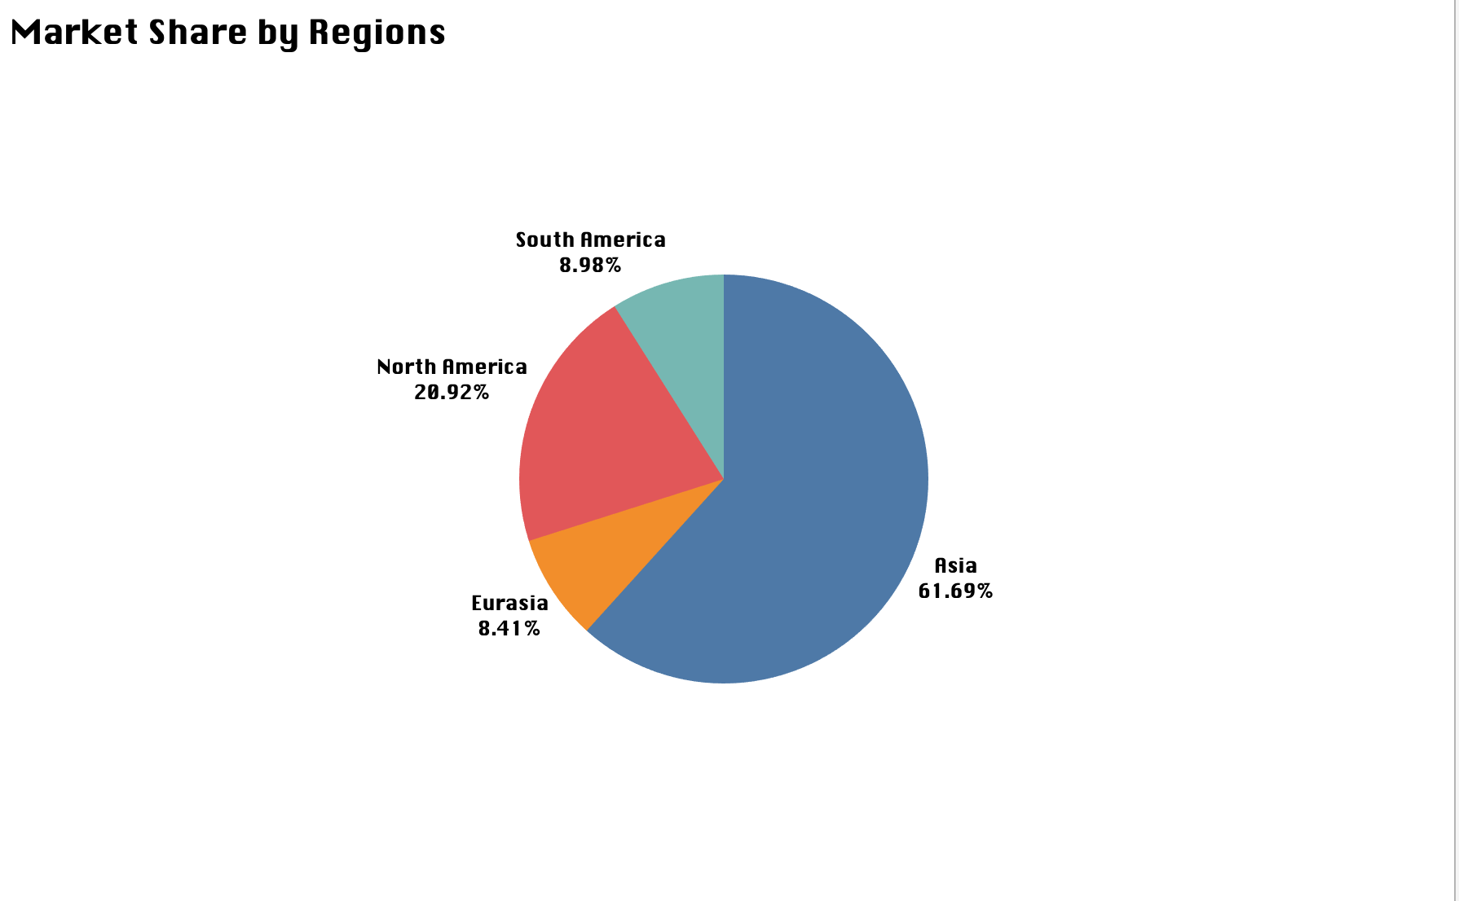
Asia has the largest market share (61.69%) for Rockbuster.
Source: Tableau

Slide 8
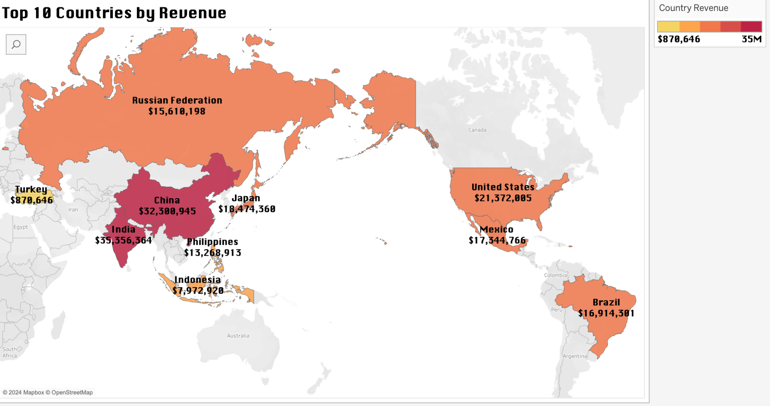
Identifying the top 10 countries will help Rockbuster allocate its resources where there will be a strategic impact.
India leads Rockbuster film rental revenue ($35 million).
Source: Tableau

Slide 9
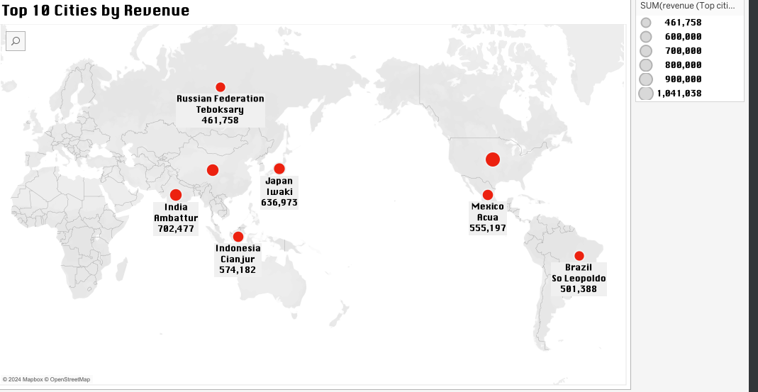
Identifying the top 10 cities within the top 10 countries listed on slide 14 will help Rockbuster allocate its resources where there will be a strategic impact. Aurora, Chicago (United States) leads in this category with $1 million.
Source: Tableau

Slide 10
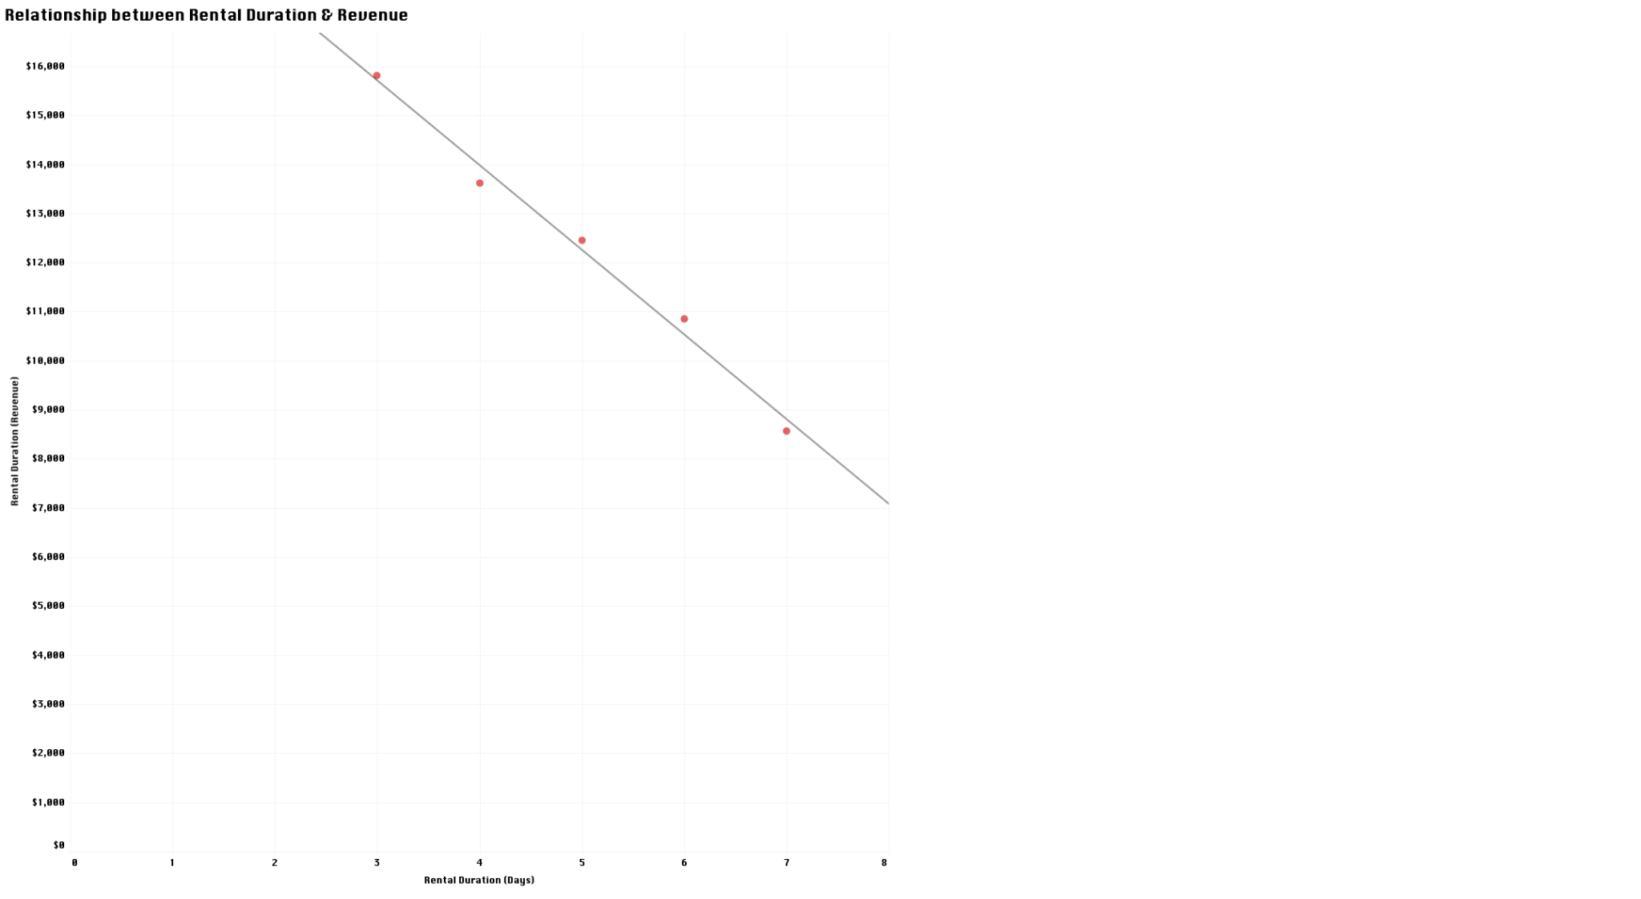
There is a negative correlation between Rental Duration & Revenue. Revenue decreases during long rental days however revenue increases during shorter rental days.
Source: Tableau

Slide 11
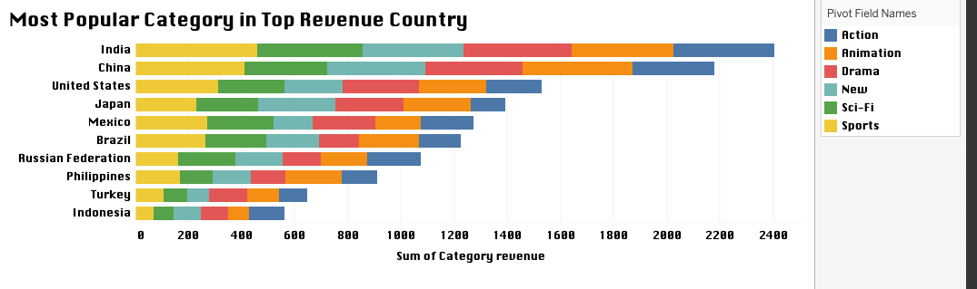
$460
$415
$312
$290
$270
$264
$215
$215
$144
$137
Action, Animation, Drama, New, Sci-Fi, and Sports were the prevailing categories within the top 10 countries. Sports was the most popular category for these countries.
Source: Tableau

Slide 12
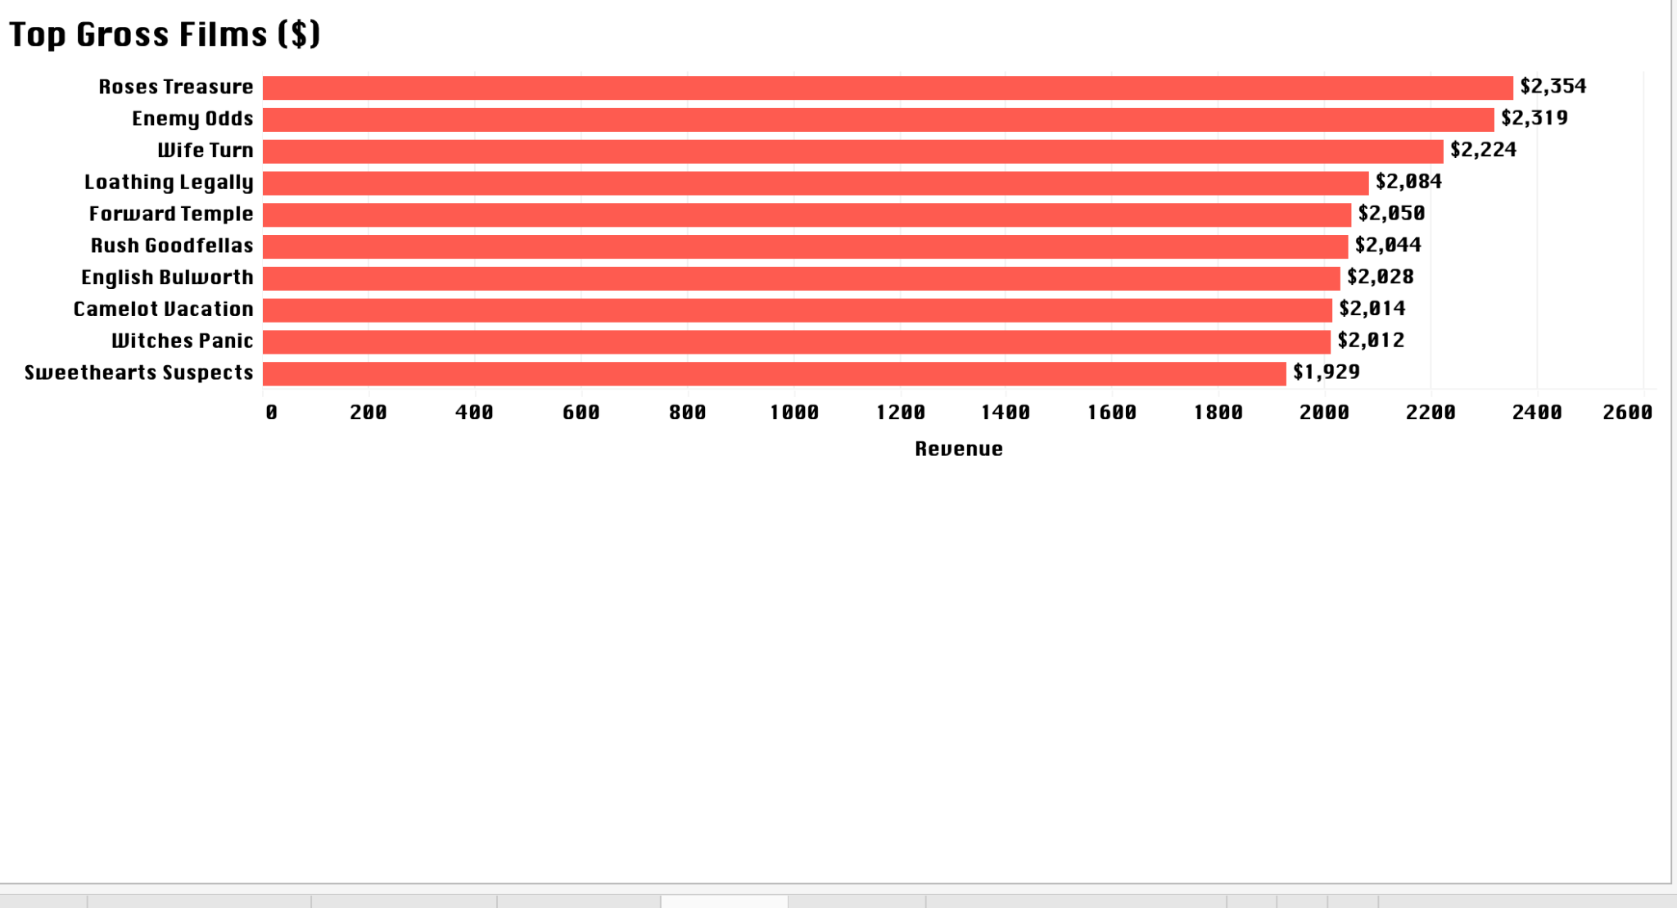
These are the top films to saw the highest revenue with Roses Treasure taking the lead at $2,354.
Source: Tableau

Slide 13
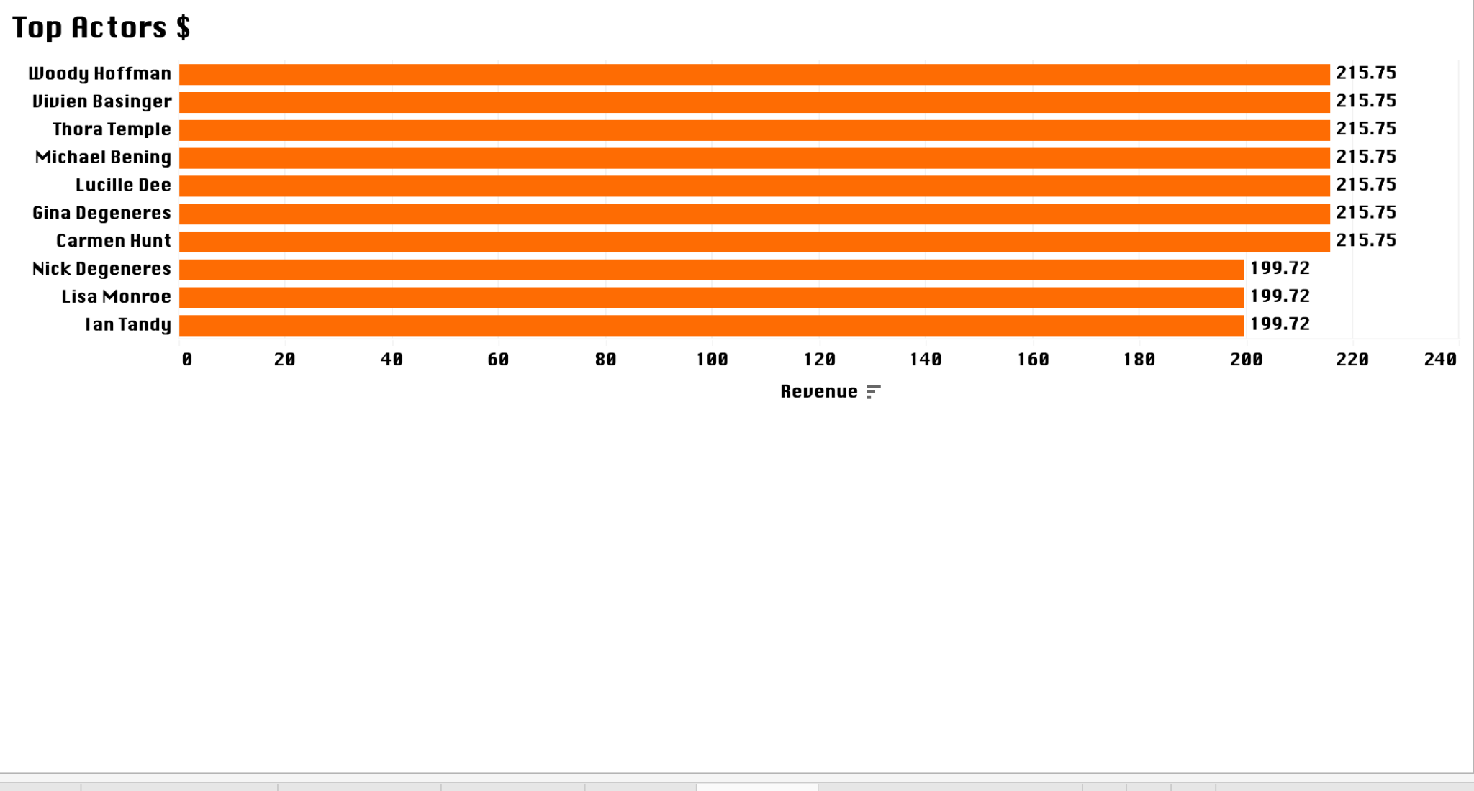
These are the top actors by revenue. The actors that share the same revenue acted in the same film.
Source: Tableau

Slide 14
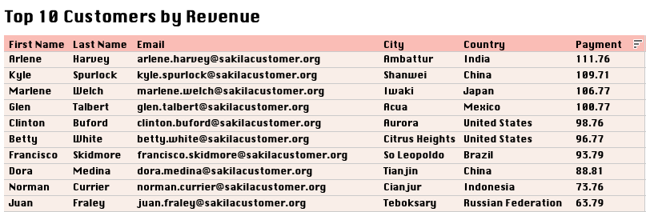
These are Rockbuster’s top 10 loyal customers and their information.
Source: Tableau

Slide 15
Insights
Insights relating to rental duration will enhance product pricing and potential revenue growth.
Asia contributes the most revenue for Rockbuster.
Although there were purchases made for all film categories available, the top categories were: Action, Animation, Drama, New, Sci-Fi, and Sports.
Identifying top countries such as India, China, The United States, Russia etc, helps your company strategically target these countries for marketing optimization, service enhancements, and ultimately revenue growth.
Identifying top performing actors could also increase customer rental.
Highlighting Rockbuster’s top customer brings on an opportunity for loyalty programs, strengthening the customer base.

Slide 16
Recommendations
Increase inventory for short films under the Action, Animation, Drama, New, Sci-Fi, and Sports category.
Prioritize the top 10 countries listed in this presentation. Increase budget allocation for the cities with the highest revenue. See slide 15.
Provide language options like Hindi, Mandarin, Russian, Portuguese, Spanish etc to increase film rentals.
Implement customer loyalty program and share winners on social media to increase Rockbuster’s brand awareness and revenue.
Enhance promotion of the top 10 films.
Improve and adjust pricing strategy for each top country/region.

Slide 17
Q&A
For further inquiries, please contact: kareemahashiru@gmail.com

Slide 18
Thank You!

